Slide 1

The European Association Medical devices
Notified Bodies
“Association Presentation
&
Vision on Revision”
1

Slide 2

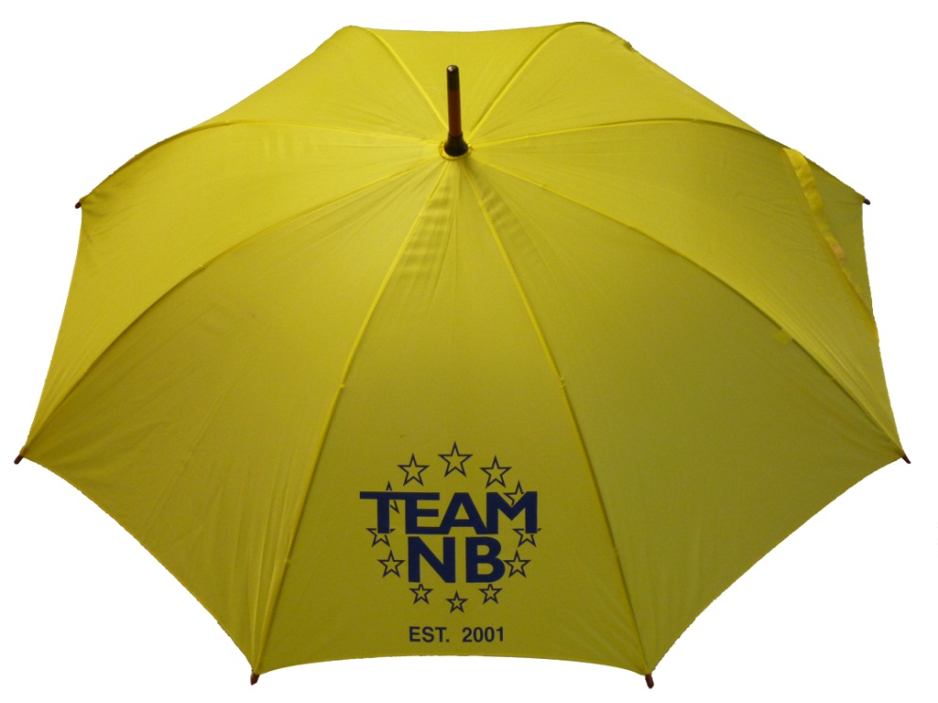
TEAM-NB
Aims:
Communication with
  European Commission
  Competent Authorities
  Industry
Promote technical and ethical standards
Participate in improving the legal framework
Contribute to harmonization
Represent Notified Bodies
Team-NB-Presentation – Vision on Revision – US embassy-20150407

Slide 3
TEAM-NB
Code of Conduct mandatory
Team-NB-Presentation – Vision on Revision – US embassy-20150407

Slide 4



Context of TEAM-NB
Commission
M
R
A
Switzerland
Canada
Australia
New Zealand
USA
Japan, …
CEN CENELEC
EMA
NB-MED
MDEG
NBRG
NBOG
COEN
Experts Groups
EUDAMED,
IVD,
Vigilance
EUROMContact,
EUCOMED, MedTech,
FIDES, EDMA, EUROM
UEAPME, Eur Assoc of Auth Repr
CPME
CMC
logo
I
M
D
R
F
Health Professionals
Notified Bodies
Manufacturers
Authorised Representatives
Notification
Accreditation
28 Competent Authorities
National Accreditation Bodies
TEAM-NB representatives
Team-NB-Presentation – Vision on Revision – US embassy-20150407

Slide 5
Code of Conduct V 3.3
Implementation, enforcement and monitoring of the Code of Conduct
Unannounced visits
Qualification and Assignment of Notified Body Assessment Personnel
Minimum time for Notified Body assessments
Sampling of class IIa and IIb technical files
Design Dossier Reviews
Rules for subcontracting
Rules for Certification Decisions
Team-NB-Presentation – Vision on Revision – US embassy-20150407

Slide 6
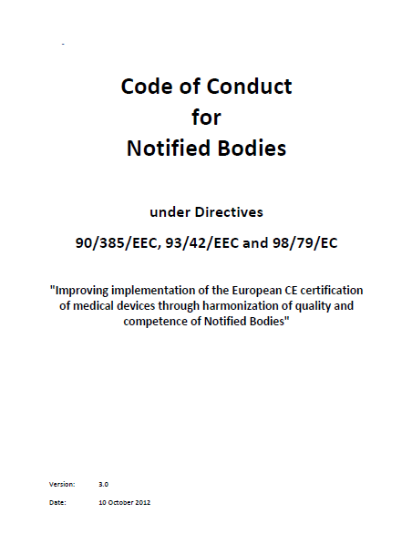
Code of Conduct V 3.3
Mandatory to sign for TEAM-NB members
Available on website www.team-nb.org
New version includes:
  Peer assessment
  Unannounced Visits
  Details on Code of Conduct Compliance Audits by TEAM-NB auditors
Version 4.0 in progress:
  raising qualification levels
Team-NB-Presentation – Vision on Revision – US embassy-20150407

Slide 7
Vision on Revision
Strengthening the system
  Improving of designation of NB
  Improving of surveillance on NB
  Harmonization of the level
    joint audit = good step forward
Team-NB-Presentation – Vision on Revision – US embassy-20150407

Slide 8
Vision on Revision
  Scrutiny
  During review
    Delay for issuing of the certificate to the Manufacturer
    At the phase of clinical trial (early stage before certification process)
  After the issuing of the certificate
  Part of the supervision of the NB
Team-NB-Presentation – Vision on Revision – US embassy-20150407

Slide 9
Vision on Revision
  Clinical knowledge
  To be raised through :
  PMS done by Manufacturers
  Vigilance done by NBs/CAs
  New guidances
  Focus clinical knowledge of CAs?
  PMS and vigilance
  Lessons learned to write guidance
  Raise the bar
Team-NB-Presentation – Vision on Revision – US embassy-20150407

Slide 10
Vision on Revision
  Classification
Classification based on risks with rules is a good option.
Lists to be replaced by risk-classification.
Some rules to be reviewed :
Active therapeutic devices
Software devices (not in 1 class)
Devices out of the medical intended use (List XV)
Example cosmetic implants :
    risk-benefice analysis could not be positive
    Focus on safety only
Team-NB-Presentation – Vision on Revision – US embassy-20150407

Slide 11
Vision on Revision
  Manufacturer under the Directive
Original Equipment Manufacturer
  Design
  Manufacture
  Placing on the market
  Own Brand Labeller
    Placing on the market with reasonable management of the devices
      Examples :
      - to have a complete portofolio
      - to complete a range
      - to start a business
Team-NB-Presentation – Vision on Revision – US embassy-20150407

Slide 12
Vision on Revision
  Single use – Reprocessing
supportive of adding control to a largely unregulated area
‘in-house’ reprocessing of single-use devices by health institutions same req.s as outsourced reprocessing
No national deviations: safety and performance of the reprocessed device are not a choice but a need
Reprocessable as basis adds too much risks to patients
A list of single-use devices for critical use which can be reprocessed, decided by the Commission with oversight from Member States, will secure a high level of patient safety. SCENIHR could advise updating such list.
Team-NB-Presentation – Vision on Revision – US embassy-20150407

Slide 13
Vision on Revision
  Traceability – Implant cards – Transparency
Supportive of improved traceability requirements
Supportive of introduction UDI
Supportive of (electronic) implant cards, also for partial implants
Supportive of good functioning accessible database
Supportive of summary evaluation report for products with periodic safety update reporting
Team-NB-Presentation – Vision on Revision – US embassy-20150407

Slide 14
Vision on Revision
  Clinical trials and evidence
Clarification of intent MemberState approving clin. Trials
Supportive of coordination on multi-country trials
Clinical experts (relevant to the field) to be used for assessment of new and innovative high risk device - most of such clinicians will not be permanent staff, as the expertise is mostly available in practicing surgeons and professors.
Team-NB-Presentation – Vision on Revision – US embassy-20150407

Slide 15
Vision on Revision
  Some further topics
PMS/PMCF – support growing emphasis for notified bodies to review continuously - DIS ISO 13485:2014/15
MDCG to become an effective forum for decision-making
  Include notified bodies in working groups
‘cosmetic implants’ – either rule based or time-limited review of positive inclusion list – clinical benefit issues
Team-NB-Presentation – Vision on Revision – US embassy-20150407

Slide 16
Vision on Revision
  Last slide on notified body qualifications
TEAM-NB members should arrange to be properly resourced with the necessary expertise
Members state designation authorities should meet the same requirements in order to supervise appropriately
TEAM-NB is of strong opinion that tightening up monitoring of notified bodies with assessments, audits and better communication is crucial to ensure a consistent level of scrutiny of manufacturers & devices across EU
Qualification requirements for personnel involved in conformity assessment procedures to be described in more detail to ensure level playing field all over Europe
Team-NB-Presentation – Vision on Revision – US embassy-20150407

Slide 17

Contacts
Management:
Gert Bos (gert.bos@bsigroup.com) – president
Hans Heiner Junker (hans-heiner.junker@tuev-sued.de) – vice president
Guy Buijzen (guy.buijzen@dekra.com) – assistant vice-president
Aud Løken Eiklid (Aud.Loken.Eiklid@presafe.com) - treasurer
Corinne Delorme (corinne.delorme@lne.fr) – secretary
Kevin Butcher (kevin.butcher@sgs.com) – CoC board president
Françoise Schlemmer (schlemmer@quasys.com) -Director and Secretariat
www.team-nb.org
Team-NB-Presentation – Vision on Revision – US embassy-20150407

Slide 18






















Members
Team-NB-Presentation – Vision on Revision – US embassy-20150407

